Slide 1
Demo: T-SQL fun in SQL Server 2025

Slide 2

Developers need better pattern matching using T-SQL

Slide 3
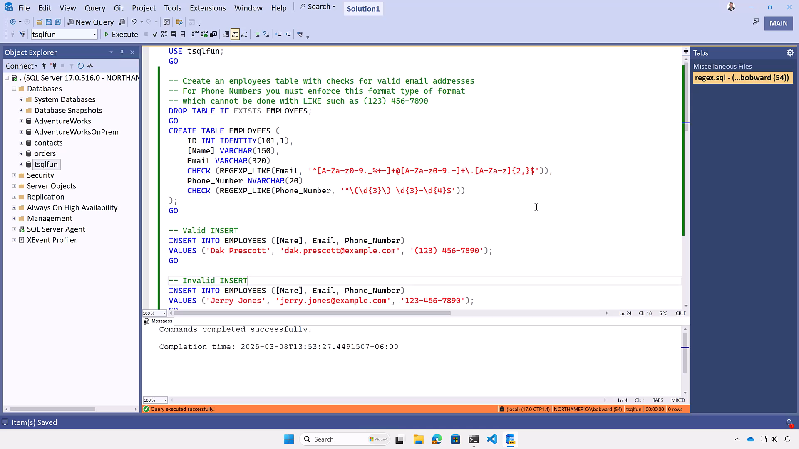
Show RegEx demo

Slide 4
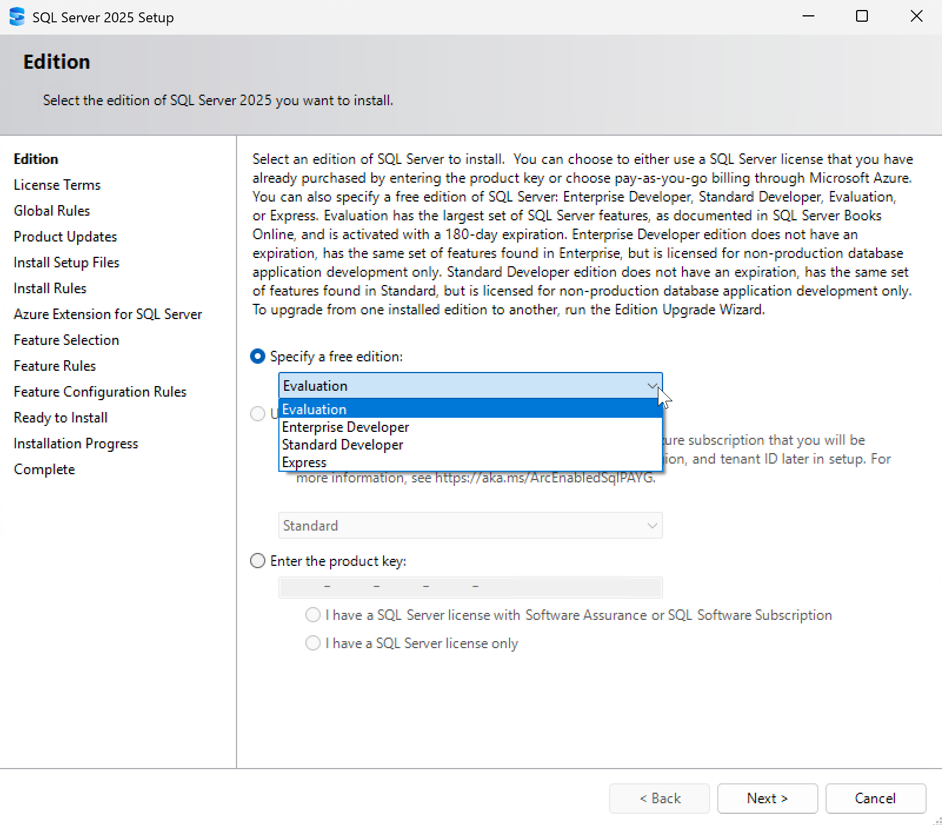
Developer Edition
Choose your target production deployment: Standard or Enterprise
Develop and test with no license costs
Features and limits match target deployment

Slide 5

Bob’s Top 5
Optimized Locking
RegEx
Tempdb RG
ZSTD Backup compression
All of the AG improvements

Slide 6

Danny’s Top 5
Redgate supports SQL 2025
Query performance improvements for read replicas
Standard Developer Edition
ADR and RG in TempDB
ZSTD Backup compression

Slide 7
Danny’s Top 5
Security Improvements
Query performance improvements for read replicas
Standard Developer Edition
ADR and RG in TempDB
ZSTD Backup compression

Slide 8


Customer experiences
“We are especially looking forward to the performance benefits of optimized locking, and the new ZSTD backup compression algorithm; the enhanced reliability of availability groups; and the continued investments in security”
“SQL Server 2025 shows great promise in improving real-world performance. Columnstore index improved query performance by over 63%”

Slide 9


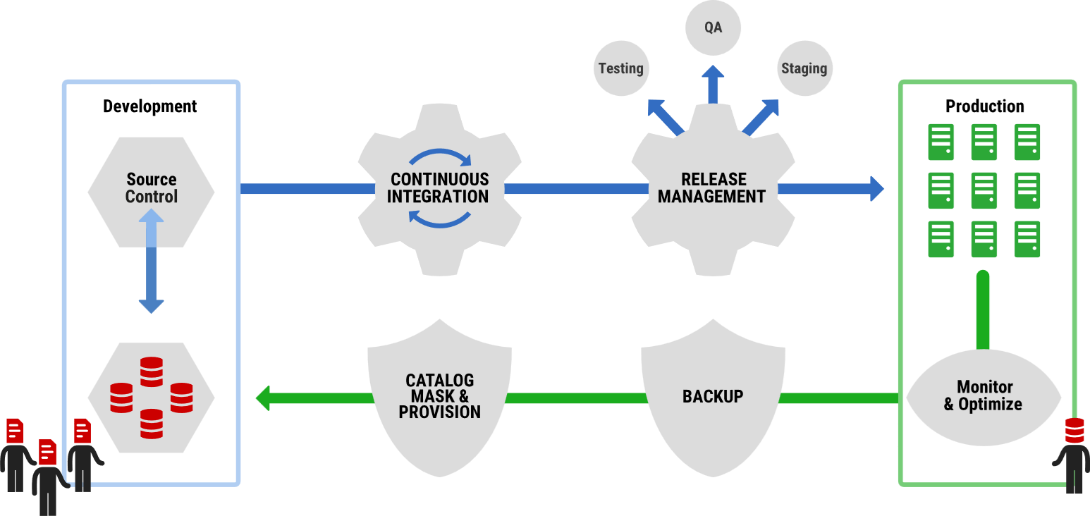



What does End-to-End Database DevOps look like?
Monitor
Subset,
Mask &
Provision
TDM

Slide 10



















The SQL Server 2025 Platform Architecture
Azure AI Agent
Azure
Microsoft Fabric
Microsoft Entra
Azure AI Foundry
Azure Functions
Azure EventHub
Managed Identity
Embeddings
Mirroring
Change Event Streaming
Azure Arc
Reliable Failover
Query Store
Tuning
Diagnostics
Backups
Data API Builder
Optimized Apps
Vectors
JSON
RegEx
Concurrency
Performance
Security
Availability Group
AI Agent Application
Secondary Replica
Semantic Kernel
Managing the Server
SQL Server 2025
sp_invoke_external_rest_endpoint
GitHub Copilot
Local Dev Container
Embeddings
SSMS 21 with Copilot
Local
REST service endpoint
Local AI Models
VS Code mssql

Slide 11














SQL Server 2025
The AI-ready enterprise database from ground to cloud
AI built-in
Develop modern
data applications
Integrate your data
with Fabric
Secure by default
Mission critical engine
Connected
with Arc
Assisted by Copilots
Benchmark
leader
Optimized for
latest hardware
Built for all
platforms
Notes:
Bob to cover

Slide 12








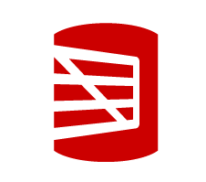
Call to Action
Check out our blogs aka.ms/sqlserver2025
aka.ms/Build/sql2025blog
Download it today
aka.ms/getsqlserver2025
Read the docs
aka.ms/sqlserver2025docs
Get the decks
aka.ms/sqlserver2025decks
github.com/ThatInfraDba
Get the demos
aka.ms/sqlserver2025demos
Give us your feedback
aka.ms/sqlfeedback
https://aka.ms/ssms-feedback
Learn from our videos
aka.ms/Build/sql2025mechanics
aka.ms/SQL2025videos
Upgrade to the new SSMS 21 and Copilot
aka.ms/ssms21
Visit the Redgate Booth

Slide 13

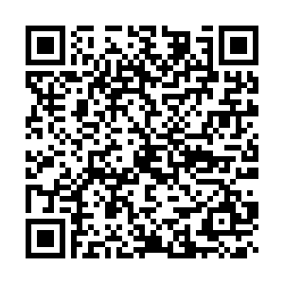

Rate Data Saturday Holland
Review to win With custom Data Saturdays lego stickers!

Slide 14


Rate This session

Slide 15









Thank you sponsors!
ata Saturdays

